Slide 1
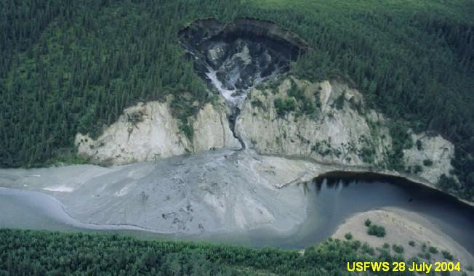


The Selawik River Mud Slide
and the
Sheefish Age and Population Project

Slide 2
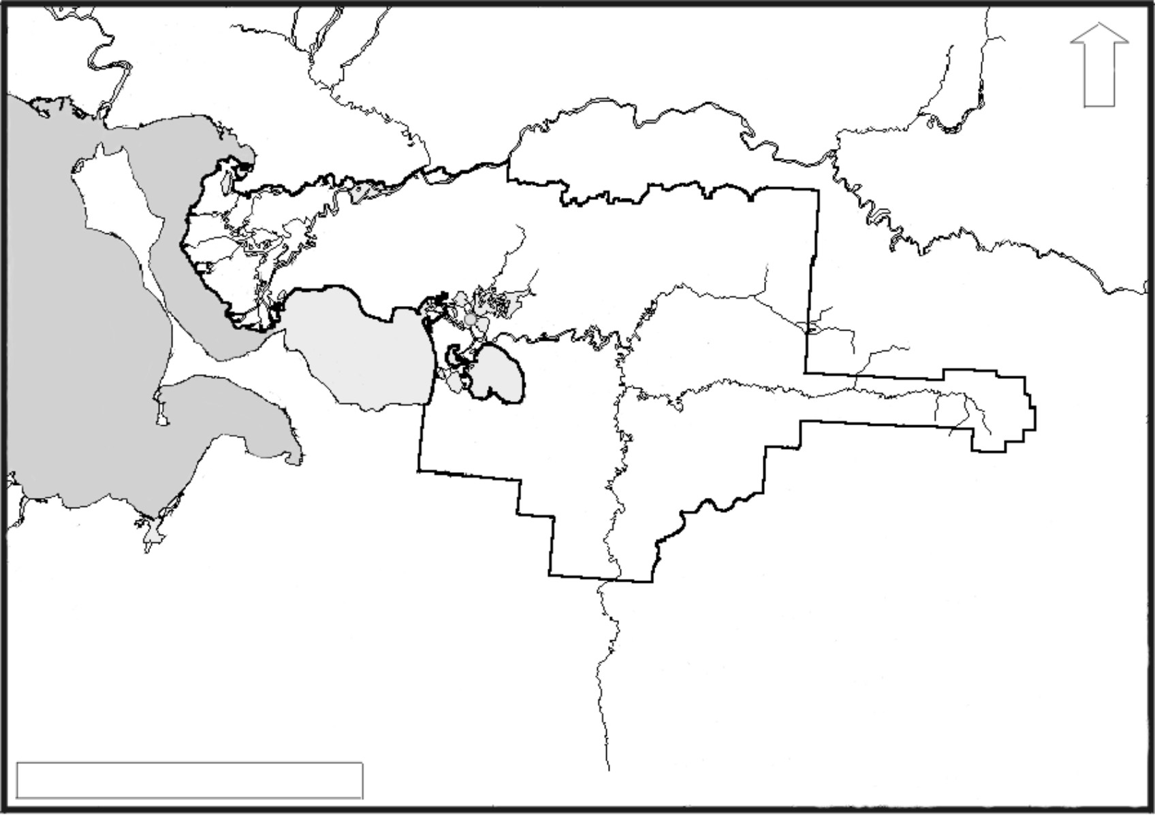
Kobuk River
N
Hotham
Inlet
Kotzebue
Selawik Village
Kotzebue
Sound
Selawik
Lake
Selawik River
Tagagawik
River
100 km
From Randy Brown

Slide 3
1981

Slide 4
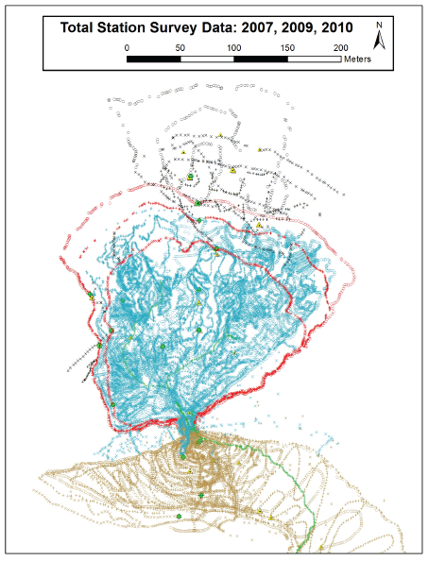
Over 100,000 points
Dr. Ben Crosby (ISU)

Slide 5
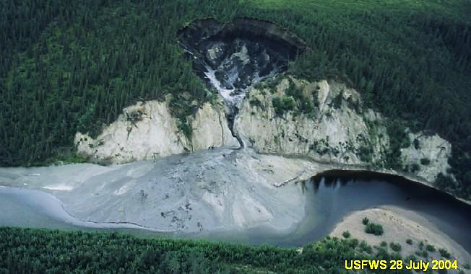
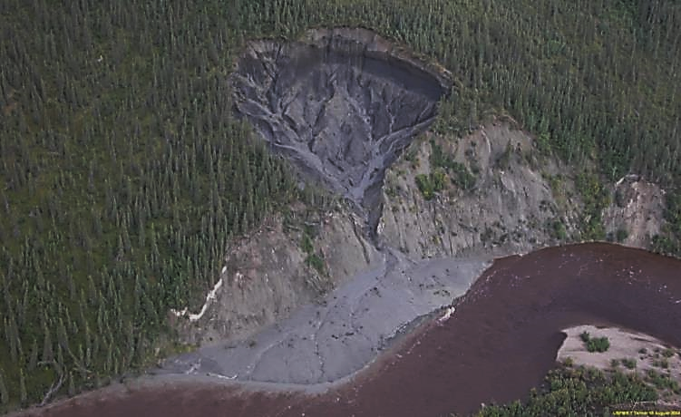
Summer 2004
Fall 2004

Slide 6
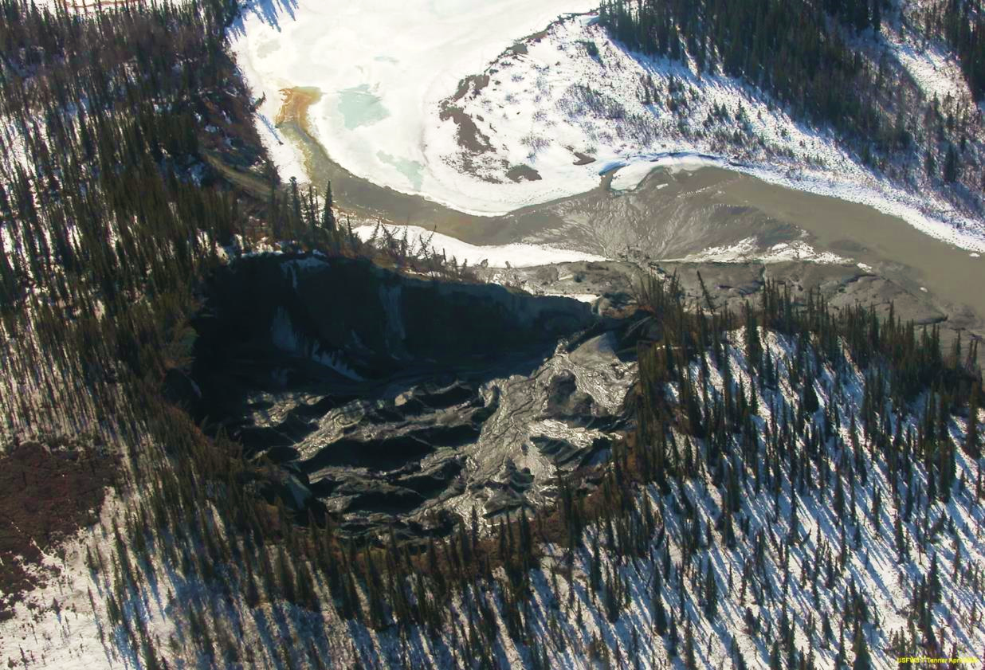
2005

Slide 7
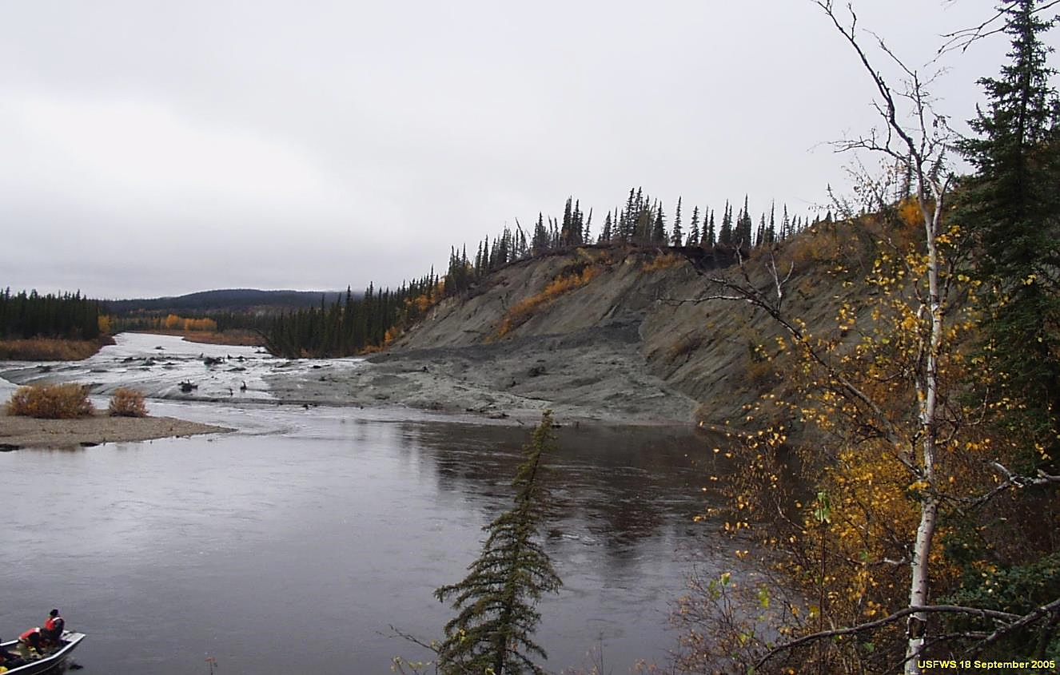

Slide 8
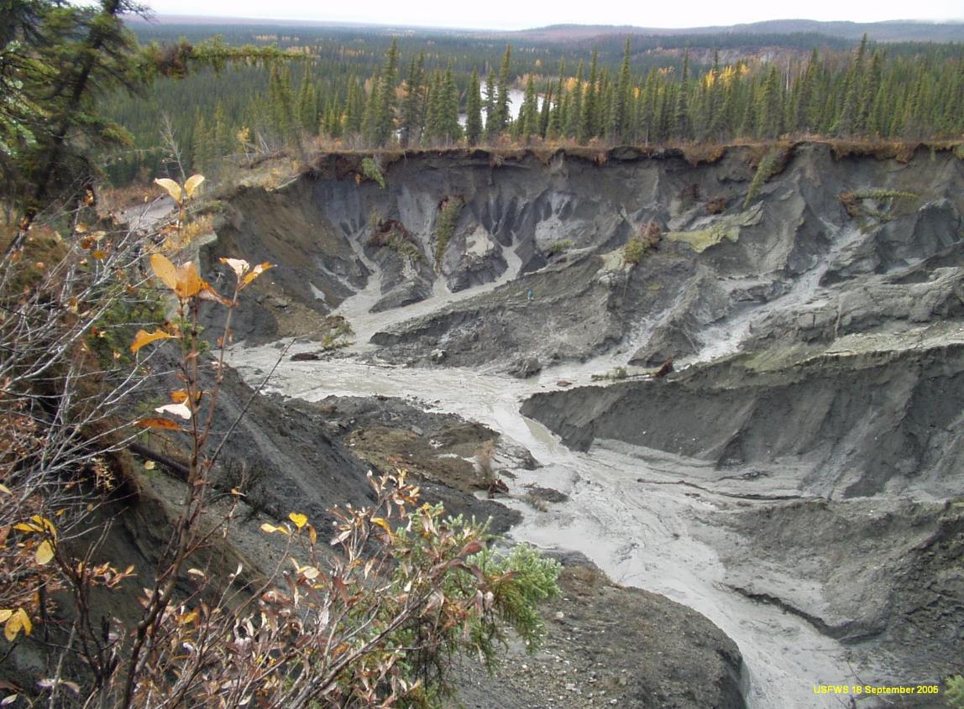
Where’s Sonny?

Slide 9
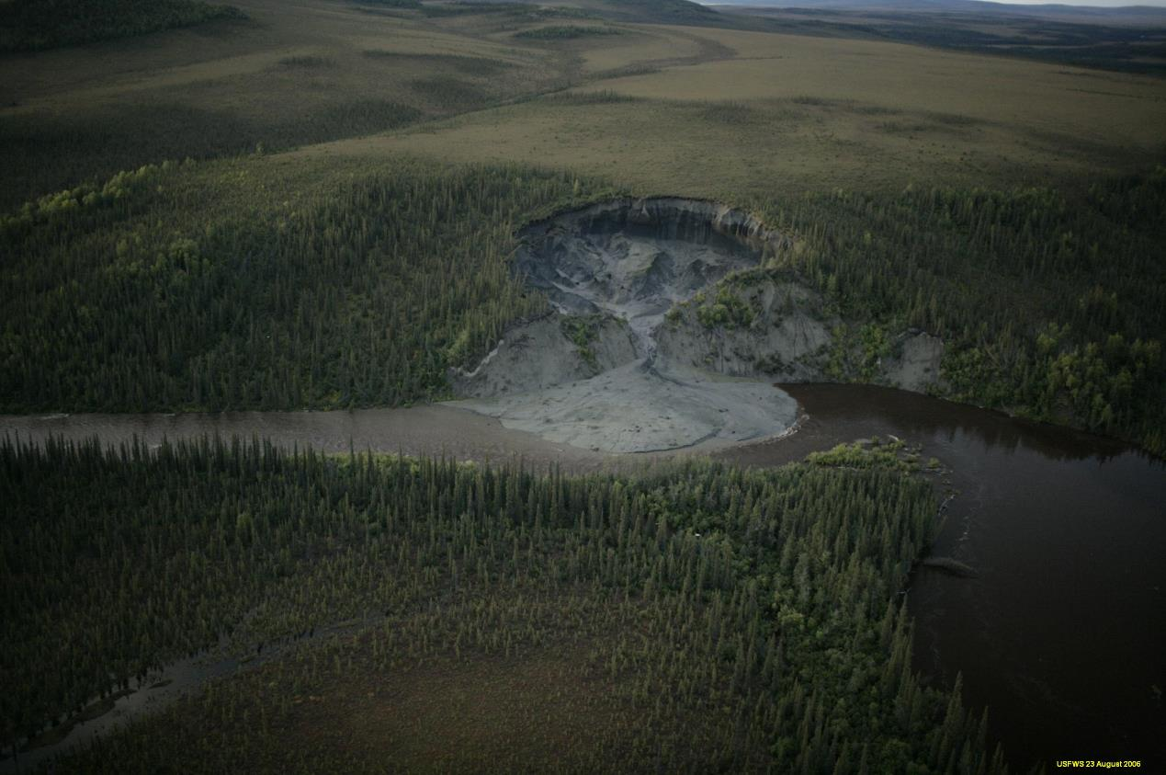
2006

Slide 10
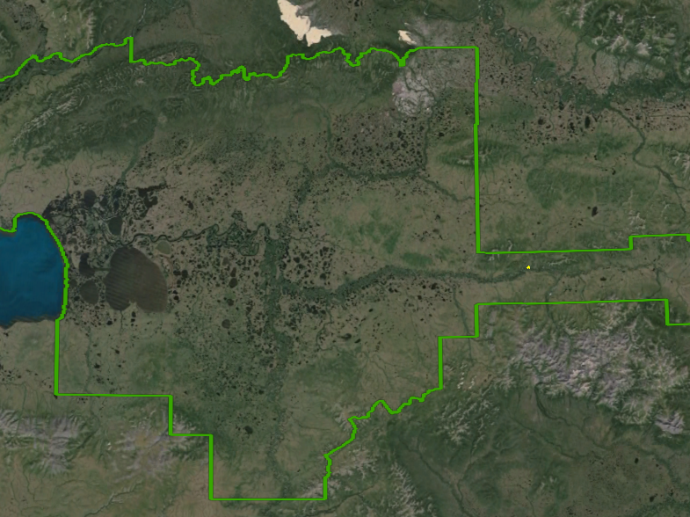
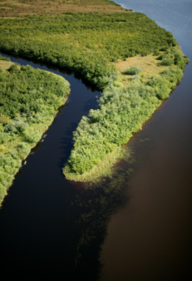
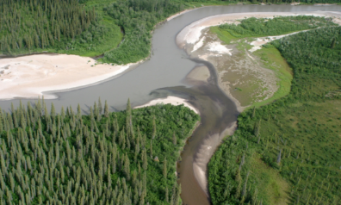
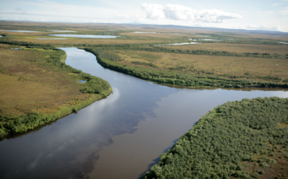
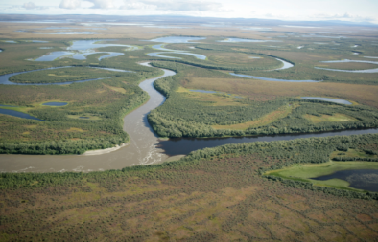


Slide 11

2006
40 km
(25 miles)
from slump

Slide 12
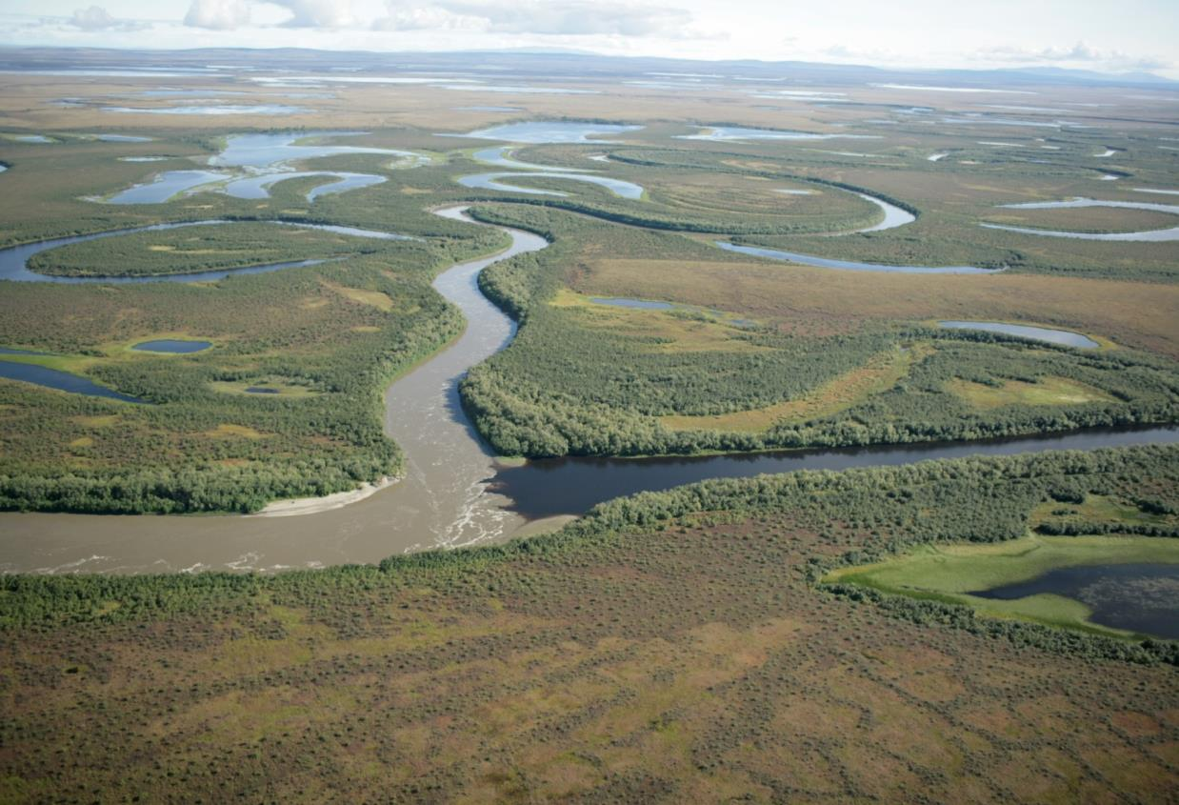
2006
153 km
(95 miles)
from slump

Slide 13
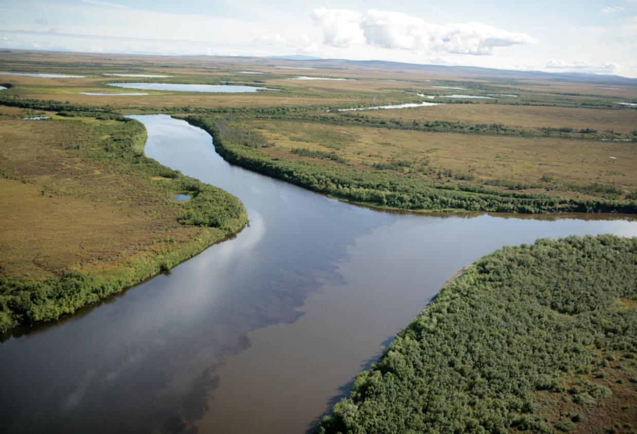
2006
187 km (116 miles) from slump

Slide 14

2006
250km
(155 miles) from slump

Slide 15
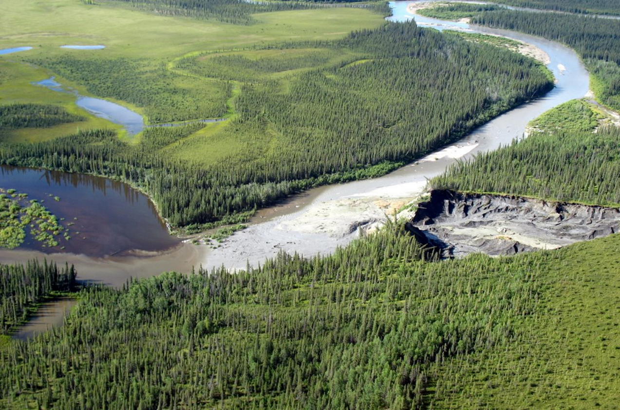
2007

Slide 16
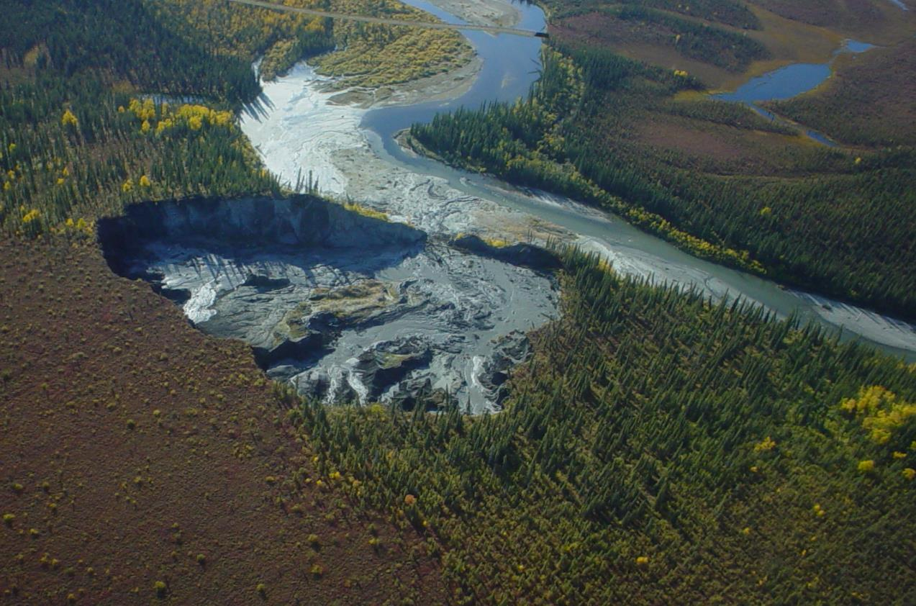
2008

Slide 17
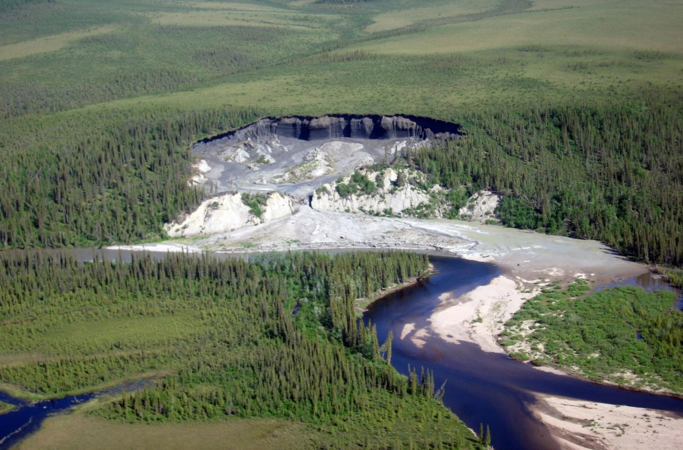
2009

Slide 18
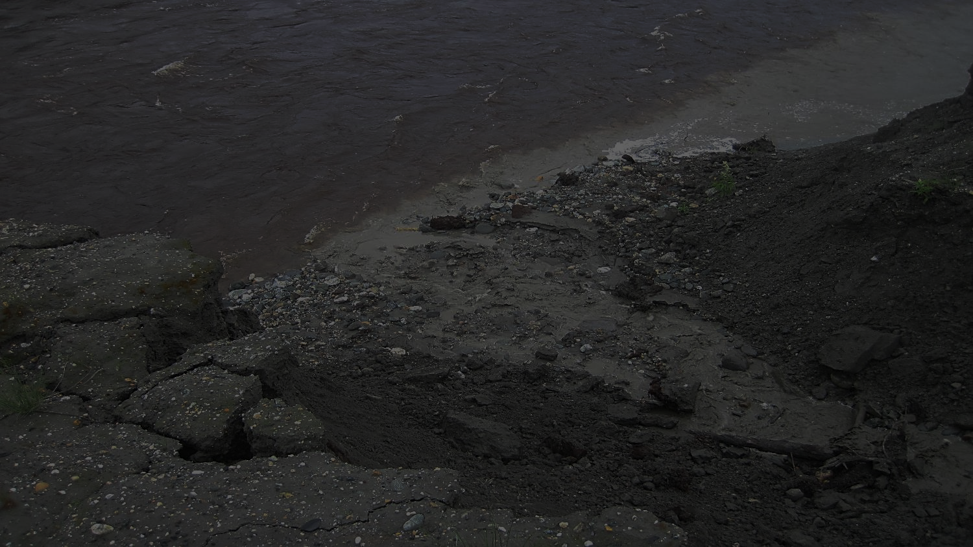
Scales and Fluxes (as of July 10, 2009)
• Dimensions: 220m x 200m (750’ x 650’)
• Height of headwall: ~25m (82’)
• Slump Area: 35,000 m² (8.7 acres)
• Fan Area: 26,000 m² (6.4 acres)
• Volume eroded: 540,000 m³ (19 million ft³)
• Volume in fan: 184,000 m³ (6.5 million ft³)
• Total vol. flux to river: 356,000 m³ (12.6 million ft³)
Dr. Ben Crosby (ISU)
Notes:
35 story building w/ footprint of football field
23 story building w/ footprint of football field

Slide 19
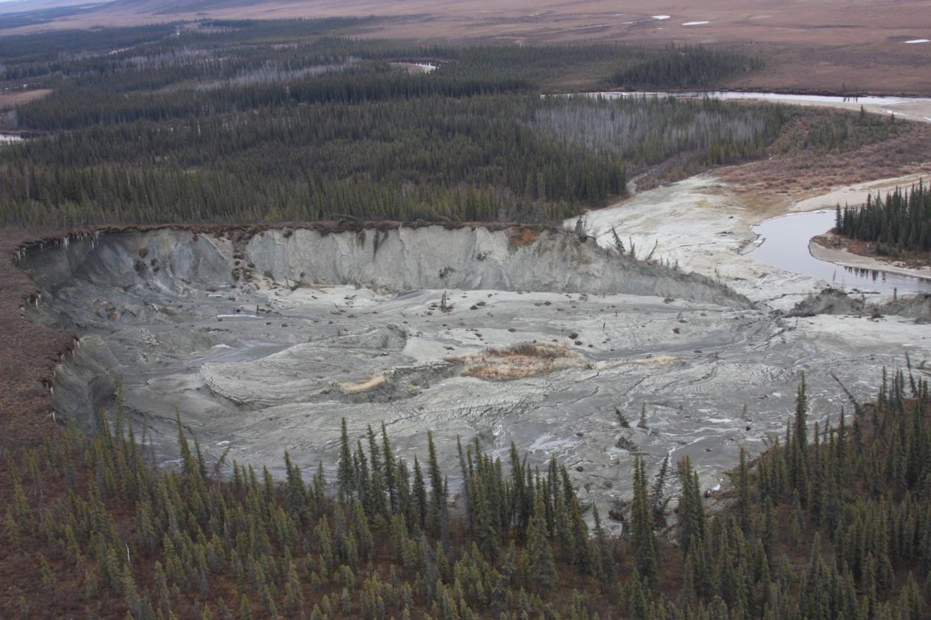
2009

Slide 20
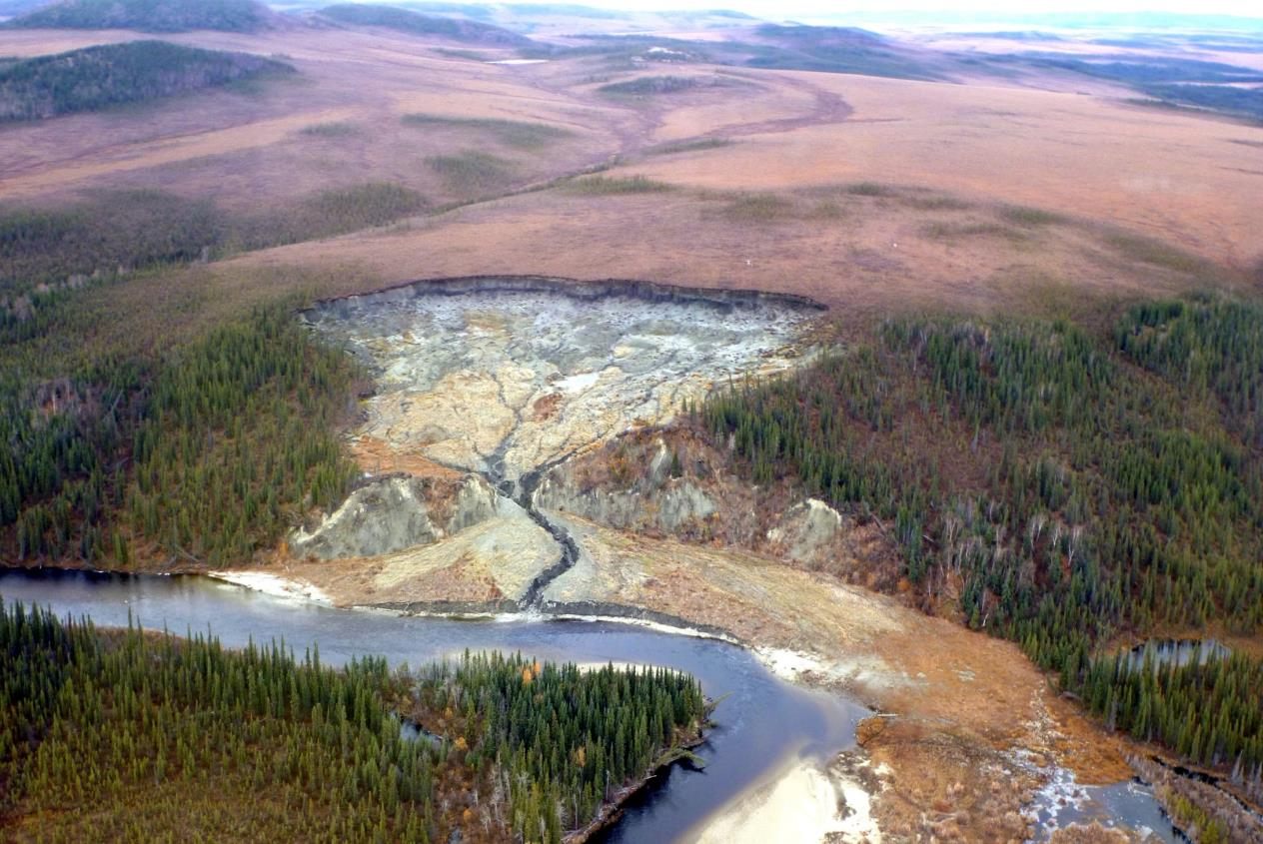
2012

Slide 21
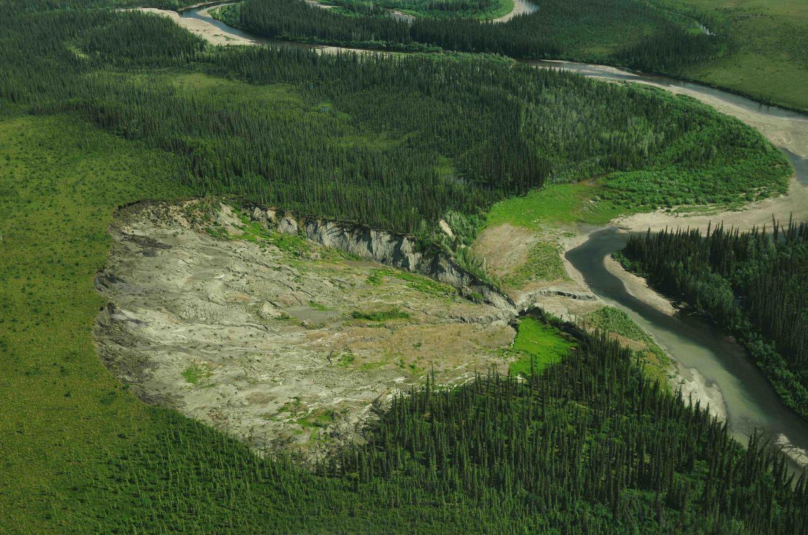
2013

Slide 22
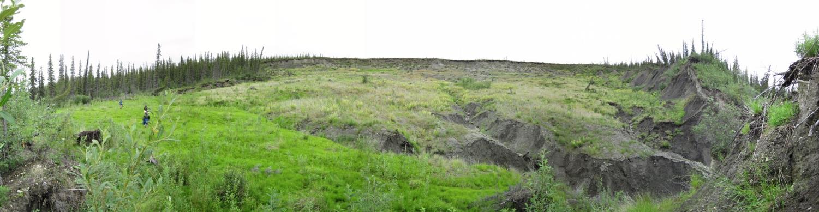
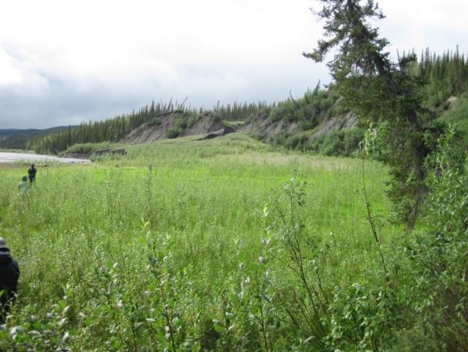
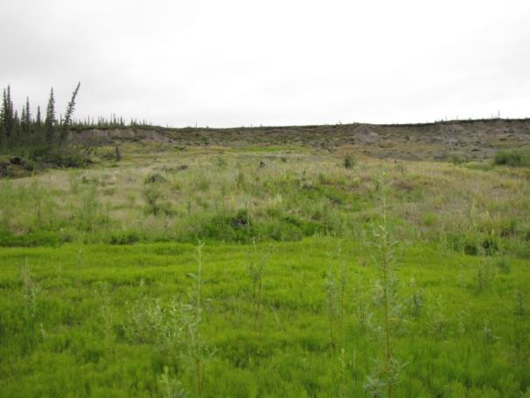
2014

Slide 23
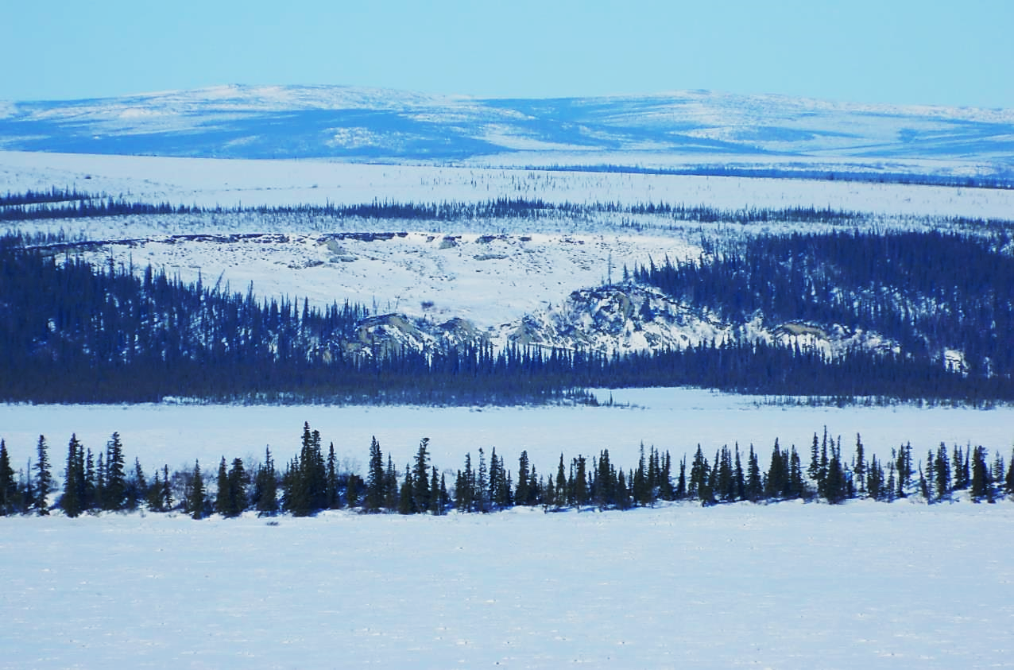
2015

Slide 24
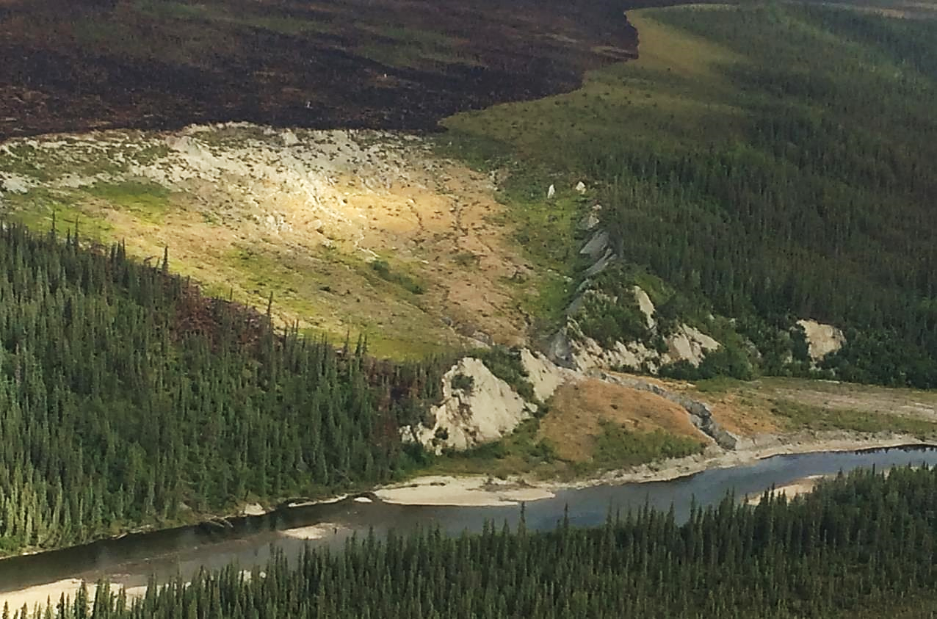
2015

Slide 25
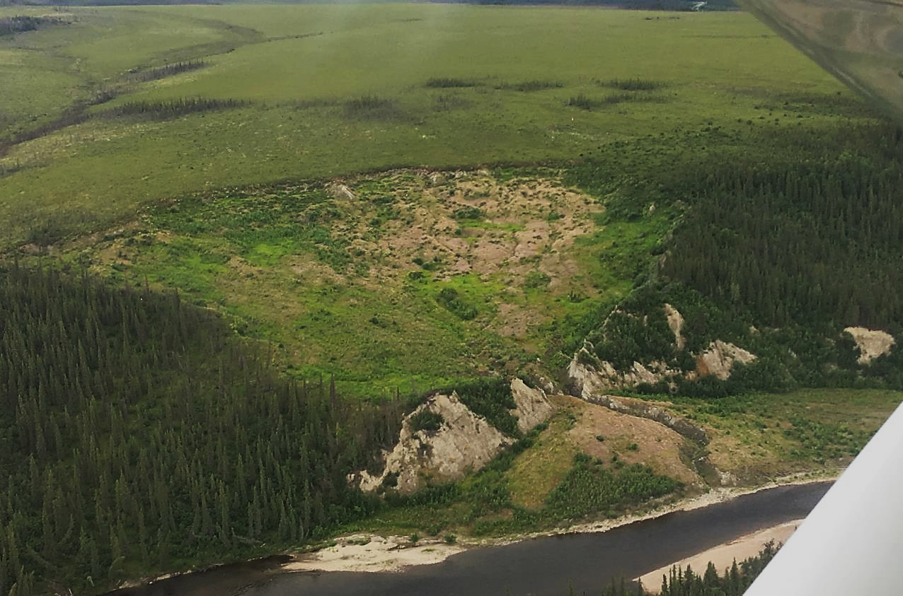
2018

Slide 26
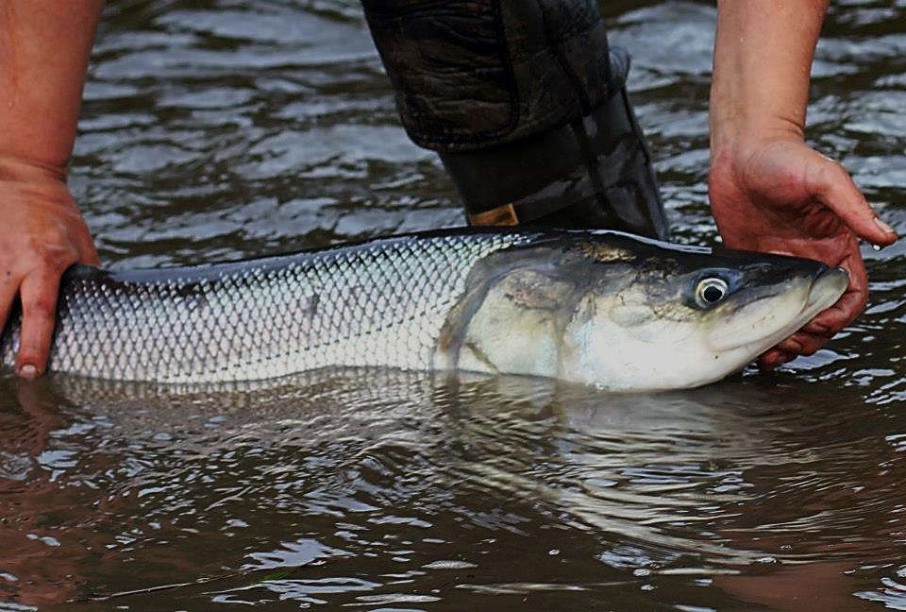
Selawik River
Sheefish Age and Abundance Project

Slide 27
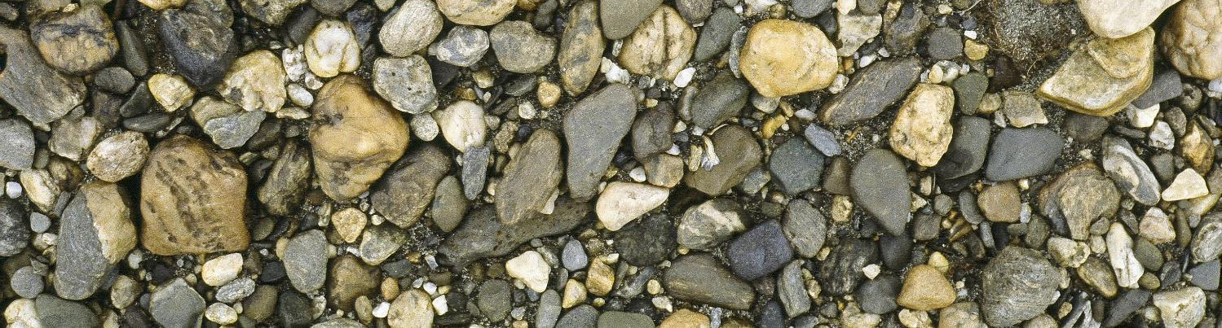
So why do we care about silt in the water?
Increased cloudiness (turbidity), impacts ability of sight-feeding fish to find food
Silt can cover gravel substrate which can smooth surface or bury eggs
Silt fills the spaces between the gravel, reducing oxygen getting to fish eggs

Slide 28
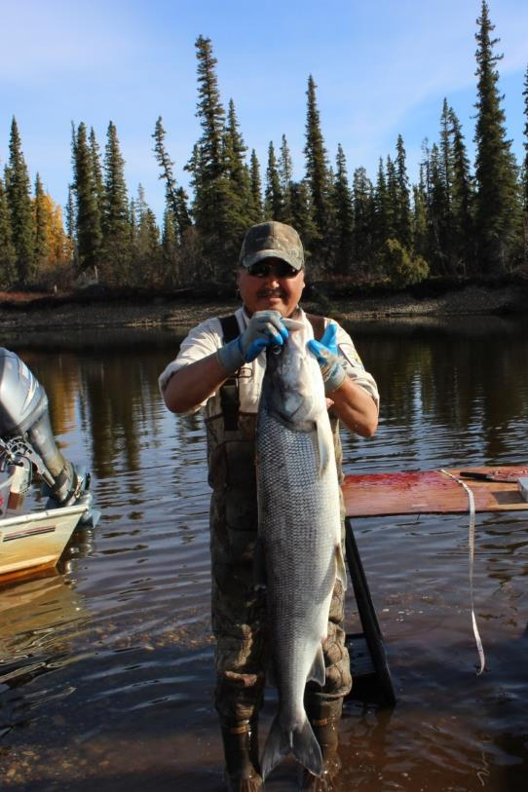
The Team
USFWS Fairbanks Field Office – started a pilot project in 2011
Fisheries biologists Ray Hander and Randy Brown from the Fairbanks Field office
Office of Subsistence Management funding for the project 2012-2019
Local team members Sonny Berry, Ingram Clark and Patrick Foster Sr.
Native Village of Selawik and the Selawik National Wildlife Refuge provided logistical and material support
ADF&G for sheefish otoliths and data from the Kobuk River

Slide 29
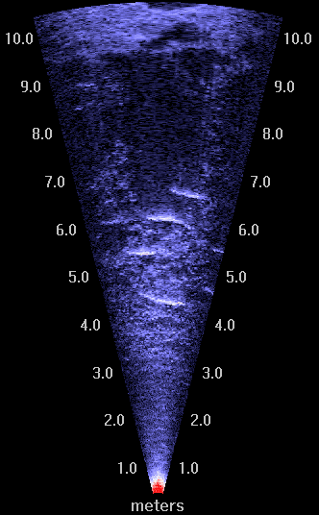
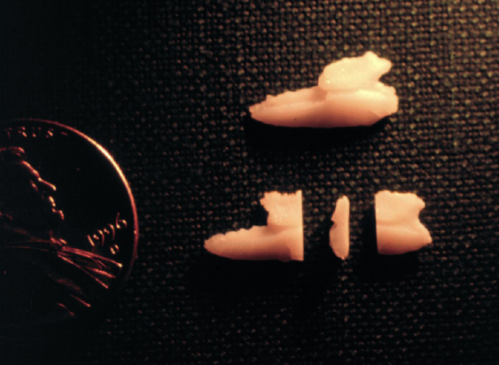
How do we detect an impact of the slump on spawning success?
Our approach was to combine:
age analysis – are post-slump hatched fish showing up in the spawning population?
spawning population data – numbers of fish coming back to spawn
Additionally, we included age analysis from the Kobuk River population as a way to tell if age class declines were region-wide or Selawik River specific

Slide 30
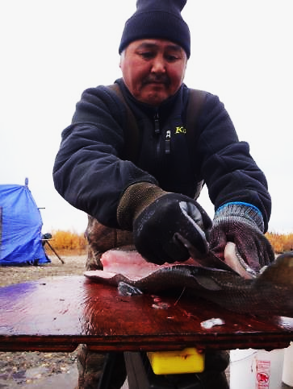
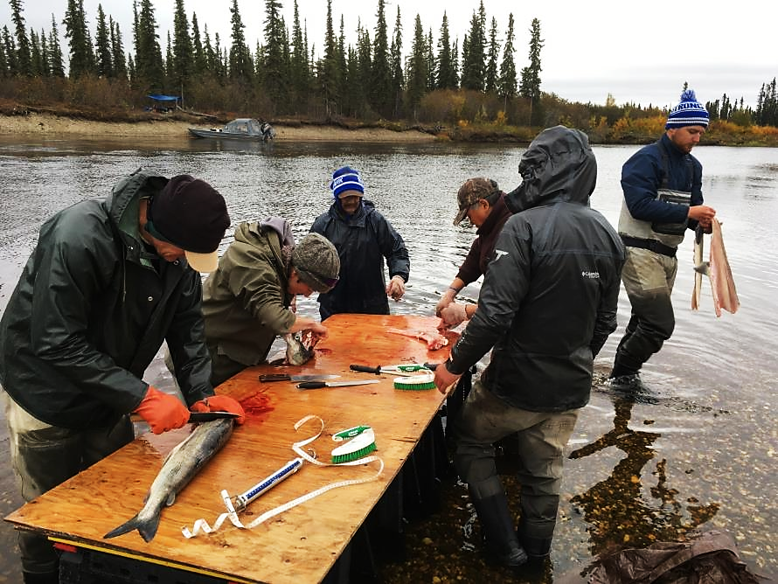
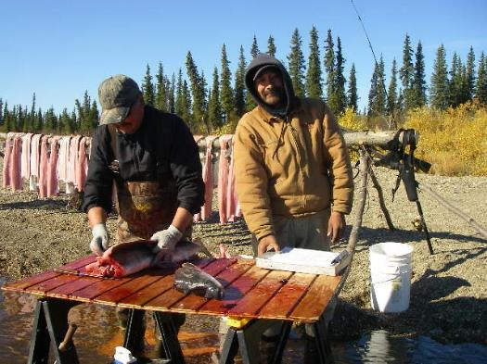
To analyze age, each year we harvest 200 male sheefish from the upper Selawik River to collect otoliths
In 2004-2005 we found there were 3 times more males in the spawning population

Slide 31
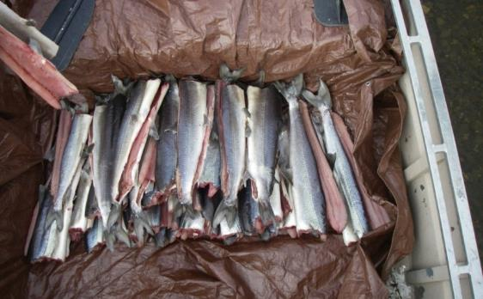
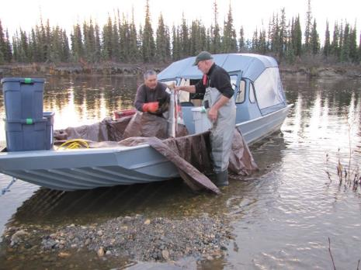
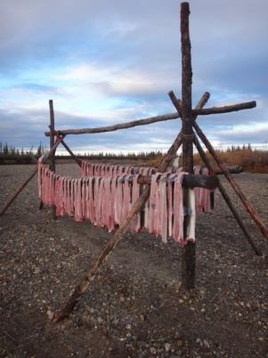
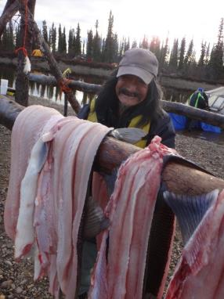
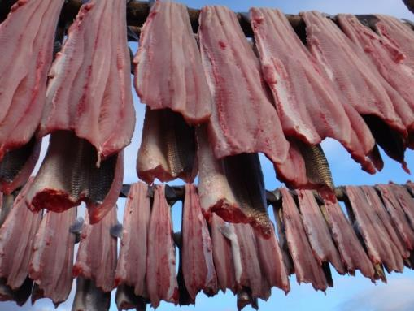
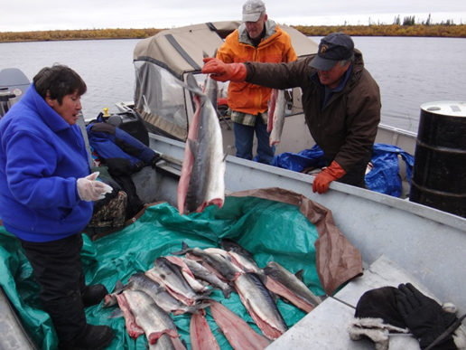
Mean weight per fish ≈ 13 lbs x 200 fish = 2699 lbs of fish

Slide 32
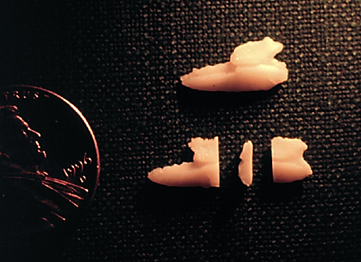
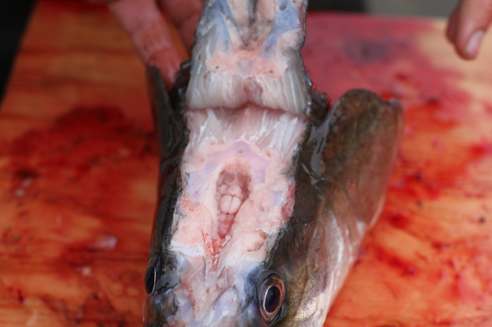
Each fish has two sets of three otoliths (ear bones)
These are 2 right otoliths
The otoliths are found
just behind the brain

Slide 33
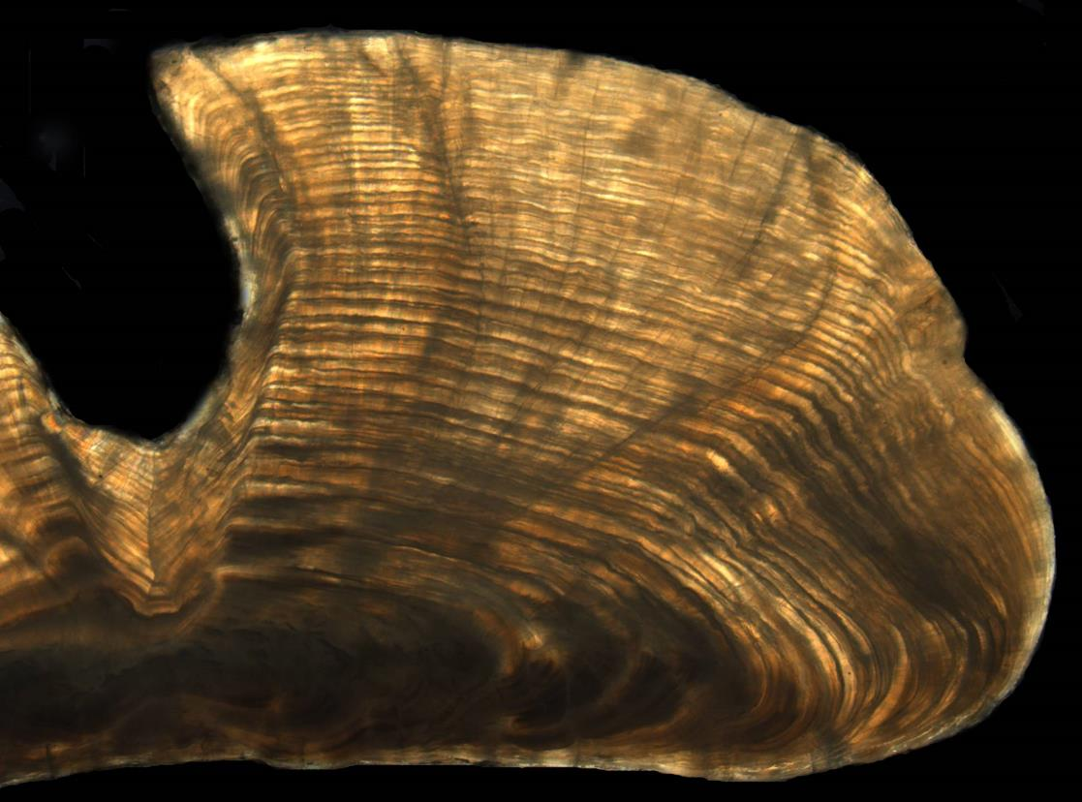
Age-41

Slide 34
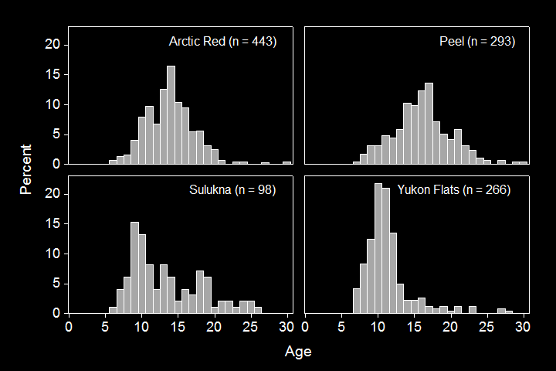
Four comparison populations
Makenzie River drainages
These graphs show how fishing pressure can influences the shape of the curve and age at maturity
Yukon River drainages

Slide 35
Seven years of Selawik and Kobuk river age distributions
While the Kobuk shows good numbers of age 10 to 12 fish, the Selawik shows low numbers of 11 and 12’s and no 10

Slide 36
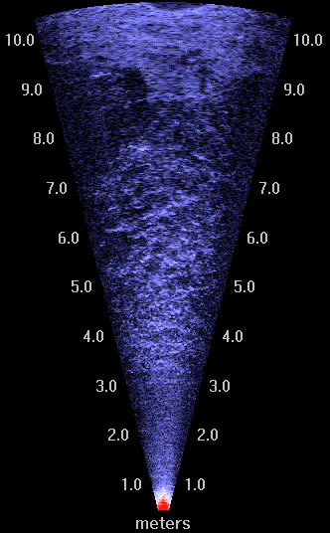
Previous population estimates were based on mark-recapture methods with a higher degree of uncertainty
Sonar is not without its drawbacks. In 2014 early icing cut counting days short and 2016 large schools of humpback whitefish likely pushed number up
Year | Estimate | 95% CI
1995 | 6,000 | 4,000-7,800
2004 | 24,000 | 13,000-33,900
2005 | 46,000 | 25,000-67,500
2011 | 20,800 | Count
2012 | 16,600 | Count
2013 | 25,000 | Count
2014 | 5,600 | Count
2015 | 18,710 | Count
2016 | 32,943 | Count
2017 | 19,237 | Count
2018 | 24,472 | Count

Slide 37
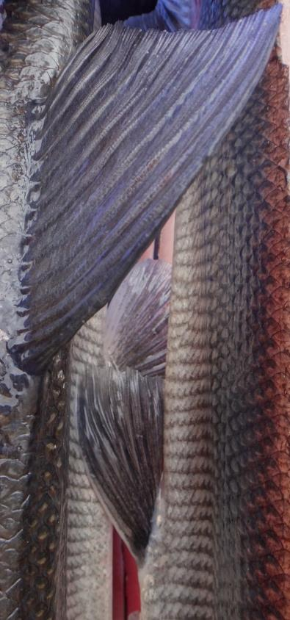
What have we discovered?
Sheefish can live a long time, many into their 30’s
In this population male sheefish spawn for the first at about 10 years old and females a little later around 12 years old
Sheefish leave the spawning grounds just as the river starts to freeze
Sheefish move quickly down river to Selawik Lake, mostly at night
Both the Selawik and Kobuk river populations are healthy and stable
Sheefish spawn many times during their life and may not spawn every year. This is to their advantage when looking at possible effects of the Slump

Slide 38
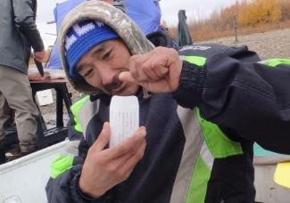









Thing go well when we work together!

Slide 39

Questions?

