Slide 1
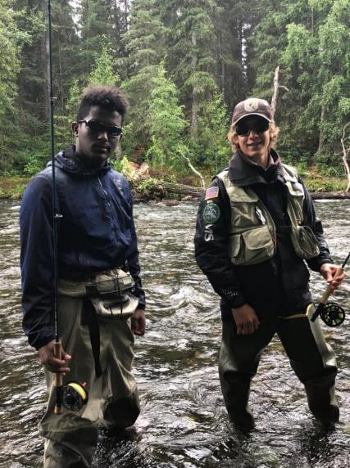
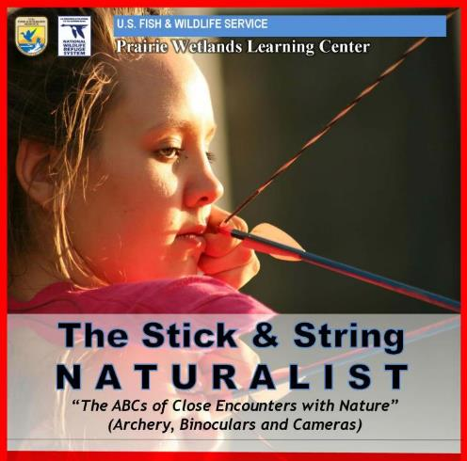


U.S. FISH & WILDLIFE SERVICE and ALASKA GEOGRAPHIC
The Stick and String Naturalist
Kenai National Wildlife Refuge

Slide 2
Why teach nature based skills?

Slide 3

The Disconnect
Biologist and writer
Robert Michael Pyle
calls this disconnect the
“Extinction of Experience.”
He asks:
“What is the extinction of the condor to a child who has never seen a wren?”

Slide 4

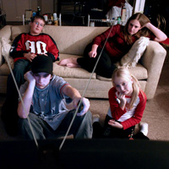

Evidence of a Disconnect
Children today spend little time in the outdoors
Survey of mothers – 71% played outdoors as children compared to 31% of their children.
Children spend 6.5 hours/day with media.
A child is 6 times more likely to play a video game than ride a bike.
59% of parents say their children have less interest in the outdoors and 91% of these parents cite television, computers, and video games as the reason.
Sale of entry-level outdoor equipment has declined.
Notes:
(Clements 2004)
(Rideout, V. et. al. 2005)
-(Cauchon, USA Today 2005)
-(Pacific Forest and Watershed Lands Stewardship Council, 2006)
-(Pergams & Zaradic 2006)
-(Outdoor Industry Association)

Slide 5
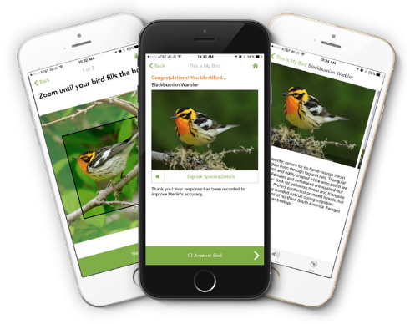
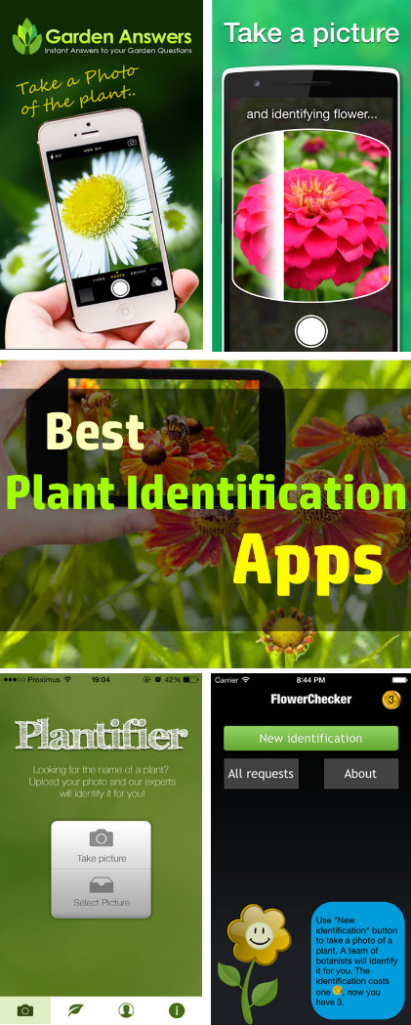
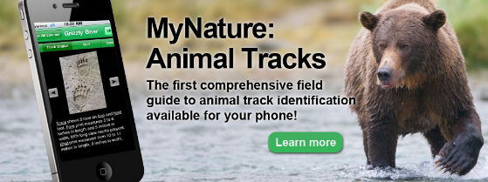
There’s an app for that!

Slide 6
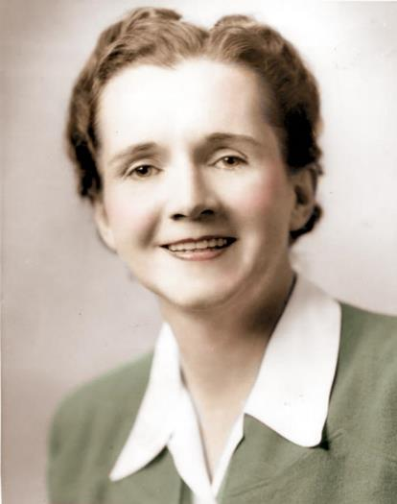

U.S. Fish and Wildlife Service
U.S. FWS biologist
Author of Silent Spring
Sense of Wonder 1956 in "Women's Home Companion"
  “Resist the urge to name everything”
Notes:
Radio scripts, essays on national wildlife refuges

Slide 7
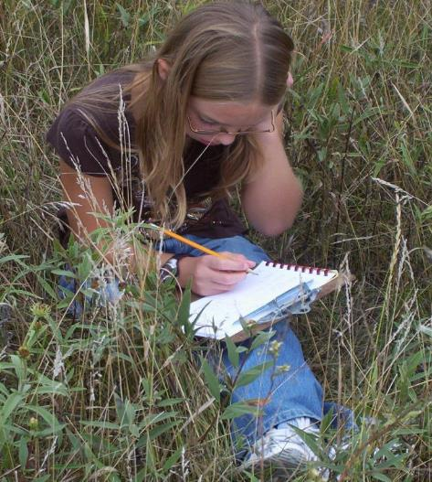
Notes:
Parallel

Slide 8
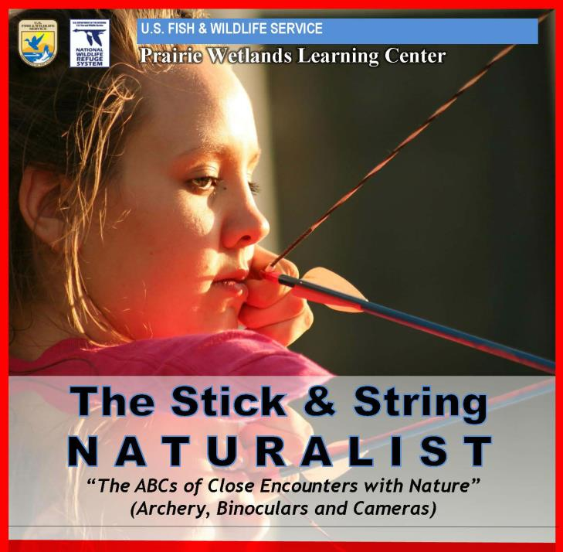

Slide 9
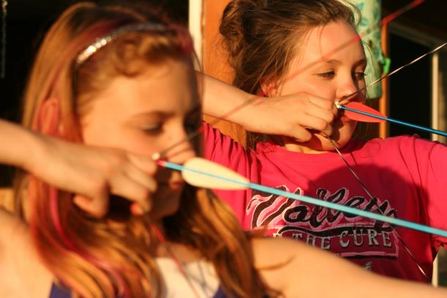
“ABCs of Getting Close to Wildlife.”
(Arrows, Binoculars and Cameras)

Slide 10

Camp Goals:
To provide an immersion experience into the world of bow hunting.
To develop an interactive learning experience without the use of PowerPoint, lectures or handouts.
To give participants the tools and techniques to pursue a lifetime passion for nature.

Slide 11
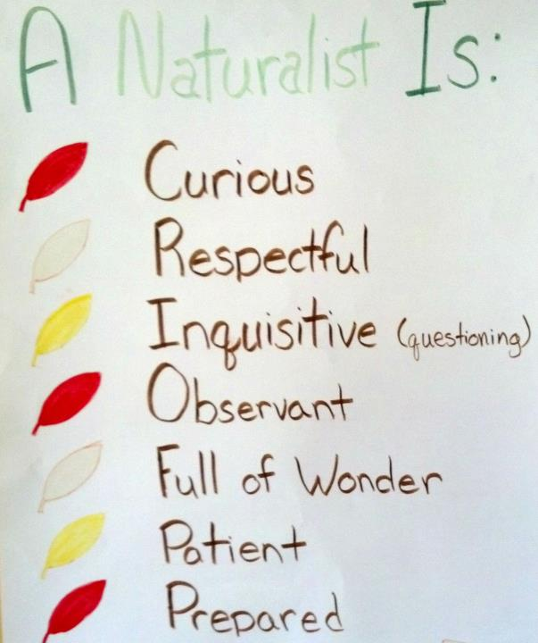

Slide 12
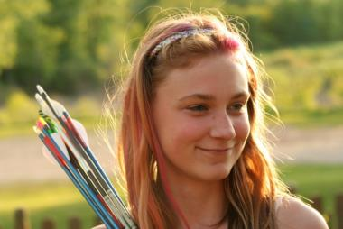
The Stick and String Naturalist
Walking in the Footsteps of Fred Bear
Taking Aim at Invasive Species
Walking with Nature: Pacing, Stride Length, and Tracks!
“You Stink!”
The Snapshot Hunter.
The Stick And String Master Naturalist Challenge!

Slide 13
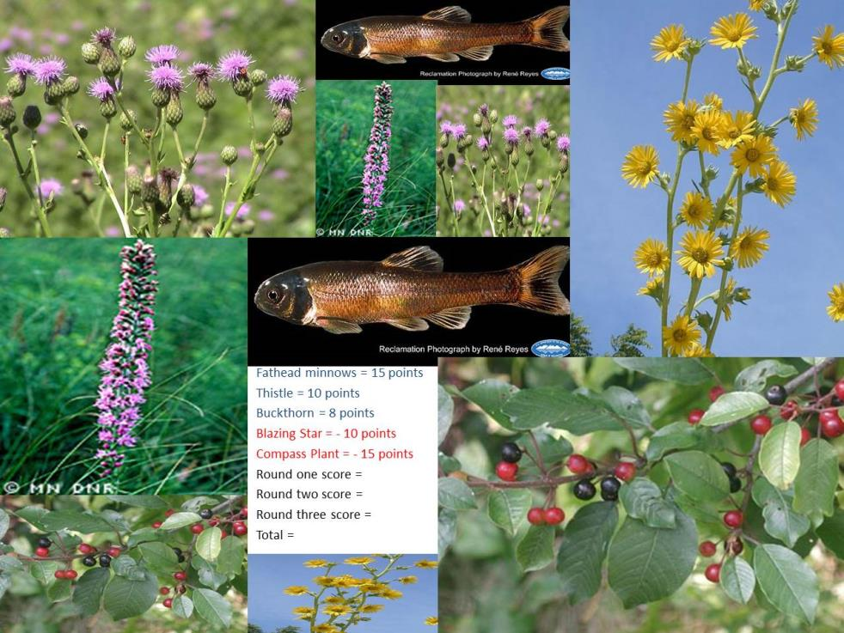

Slide 14
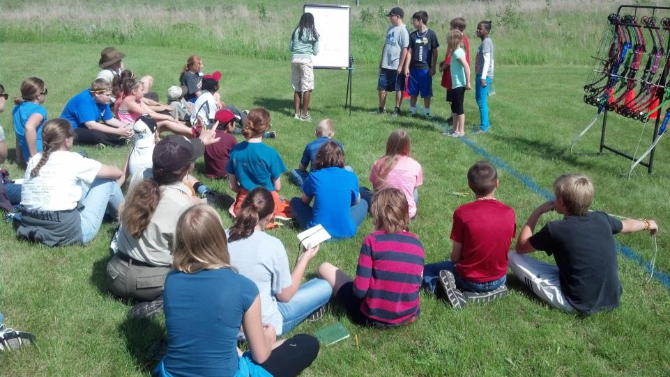

Slide 15
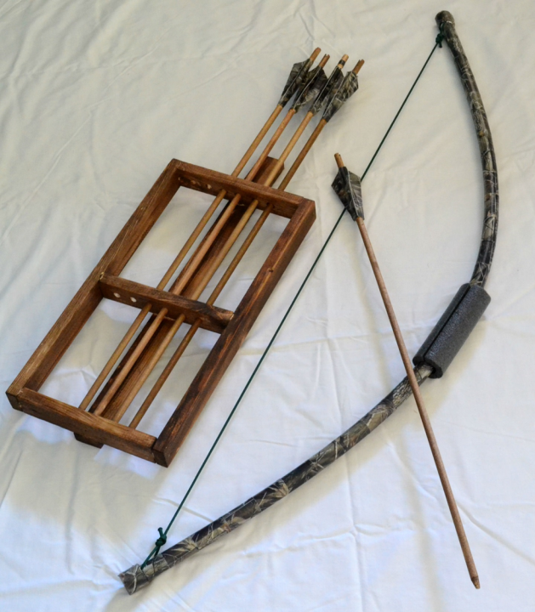

Slide 16
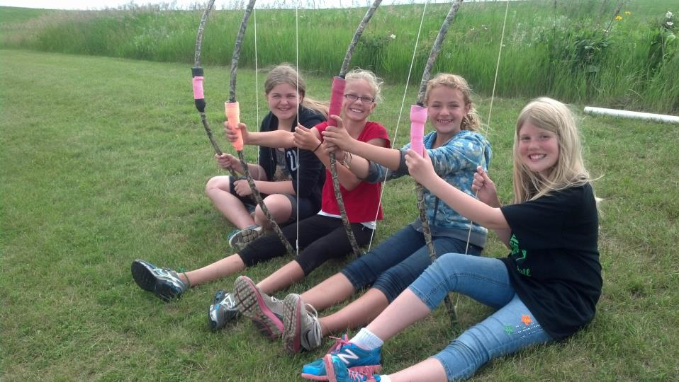

Slide 17
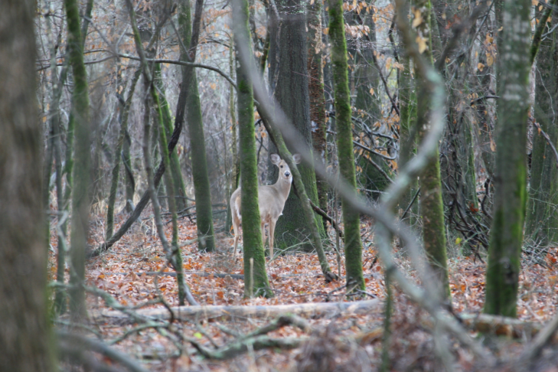
Wednesday
Tracking and the art of seeing

Slide 18
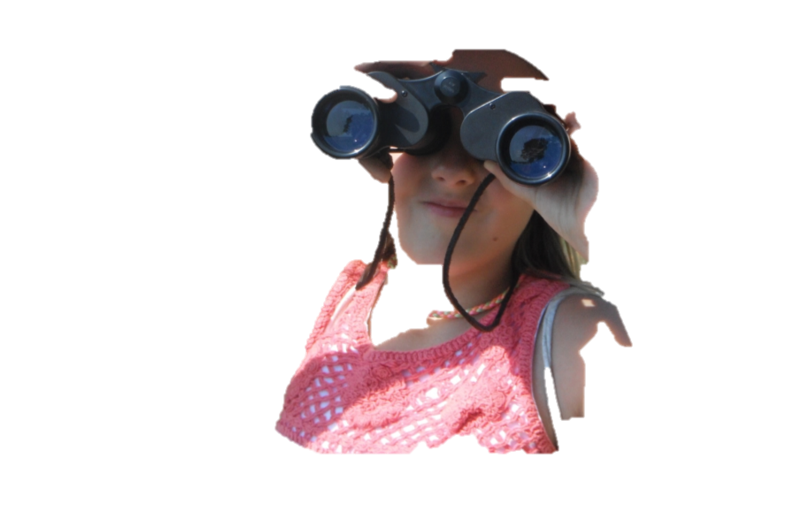
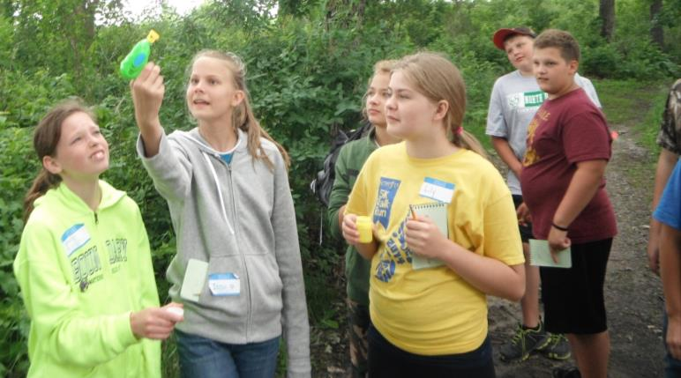
Tracking and the art of seeing

Slide 19
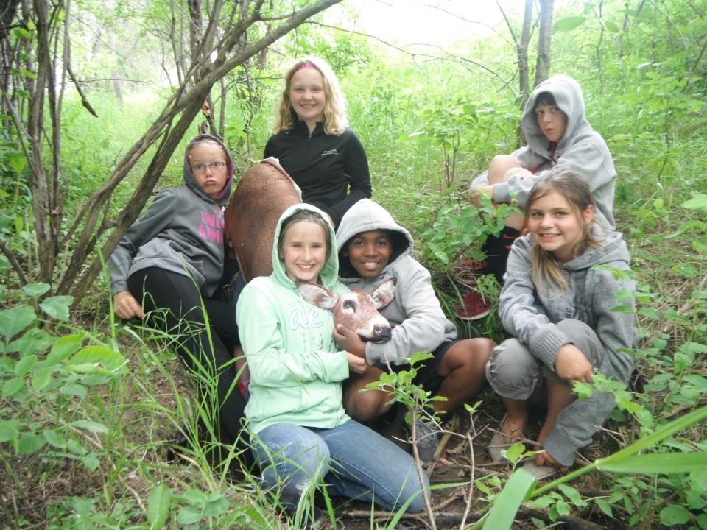

Slide 20
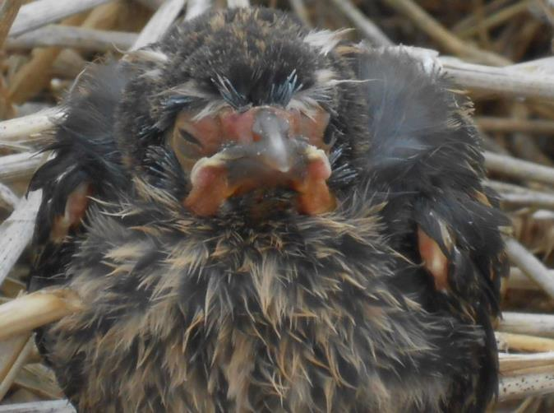
Thursday
The “snapshot” hunter; pursuing wildlife through the lens.

Slide 21
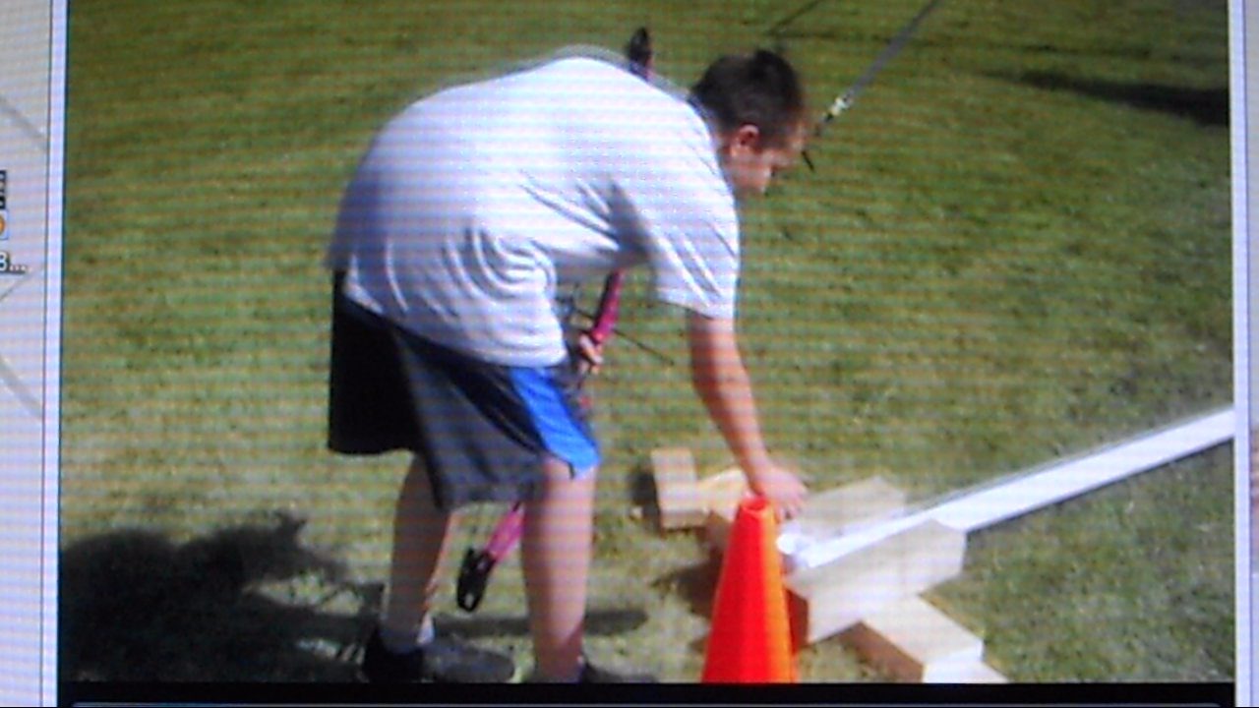

Slide 22
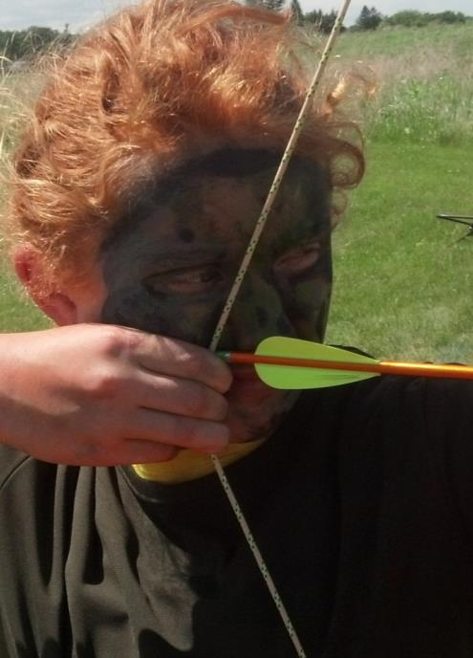
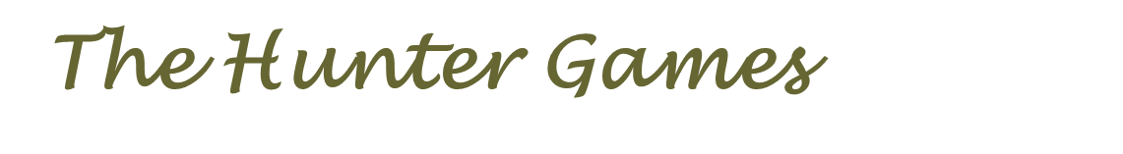
Friday

Slide 23
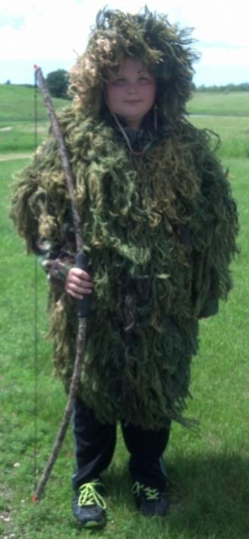

Slide 24
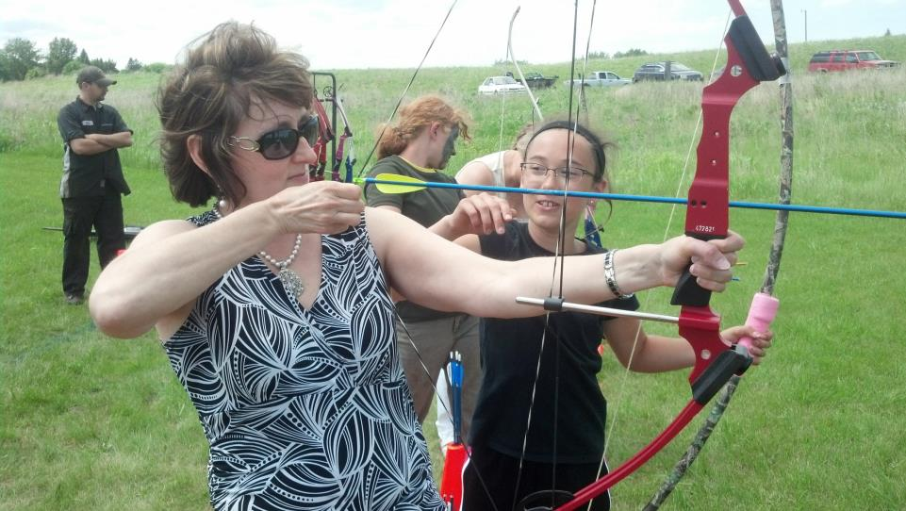
Pay it forward!
You are now the instructor!

Slide 25
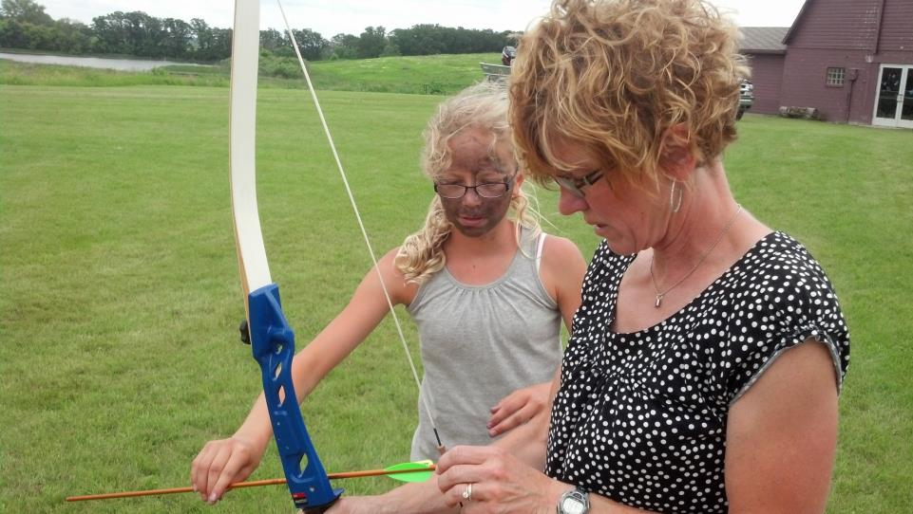

Slide 26

U.S. FISH & WILDLIFE SERVICE and
ALASKA GEOGRAPHIC
The Stick and String Naturalist
Kenai National Wildlife Refuge

Slide 27
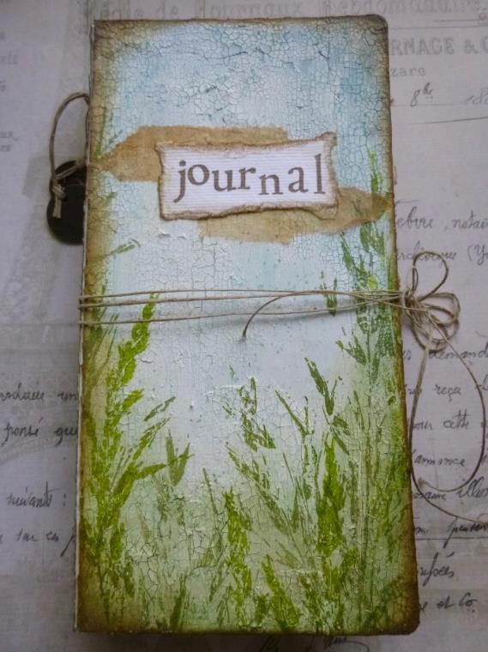

Slide 28
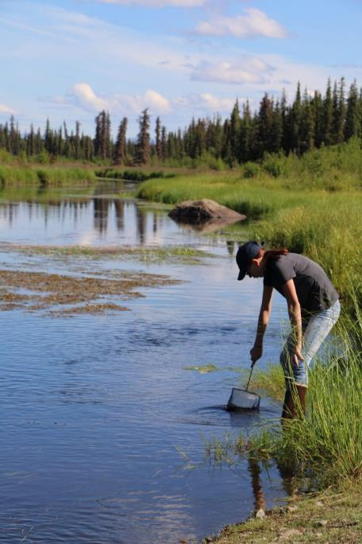

Slide 29
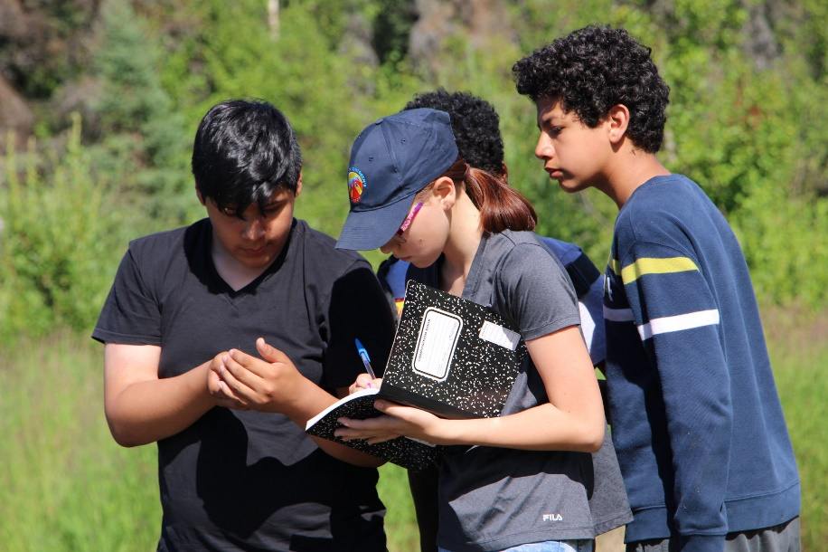

Slide 30
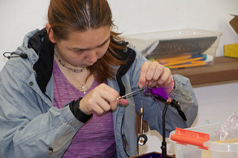

Slide 31
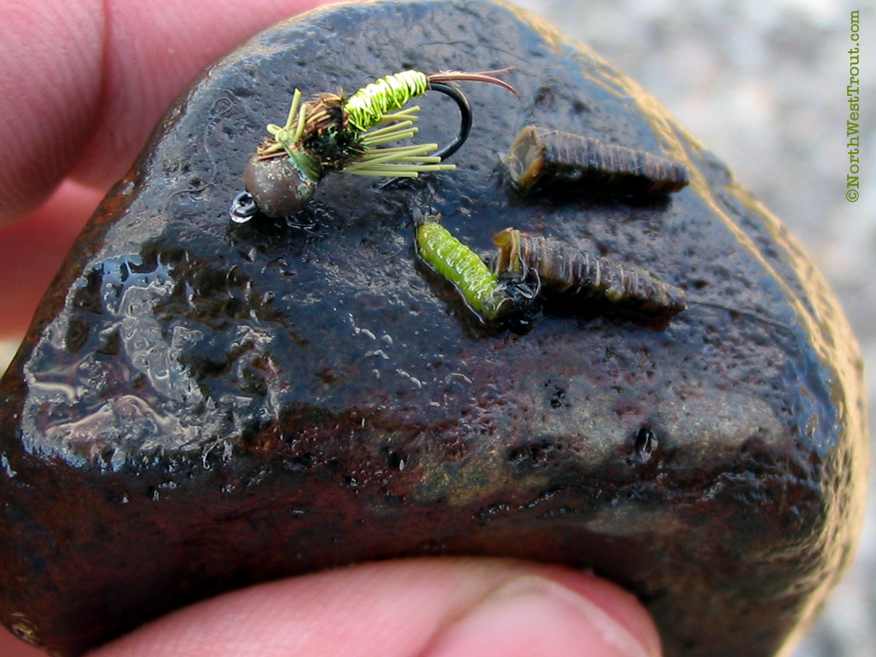

Slide 32
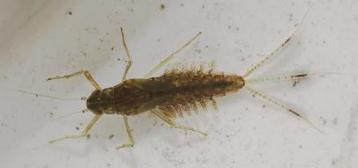
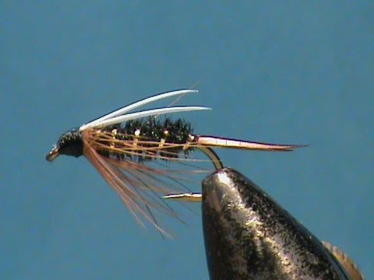

Slide 33
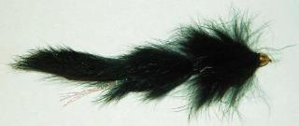
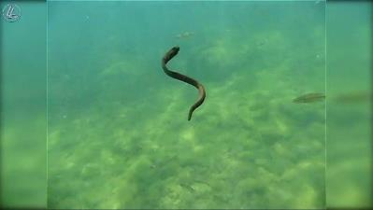
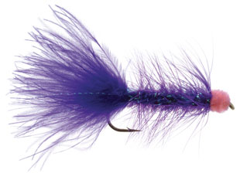

Slide 34
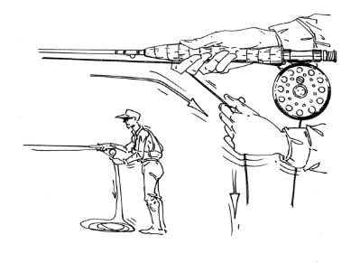
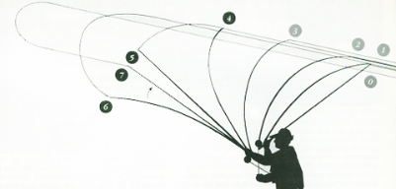
Fly casting 101

Slide 35
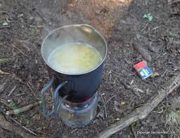
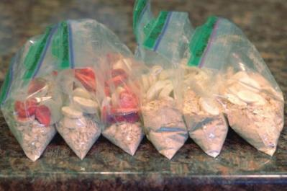

Slide 36
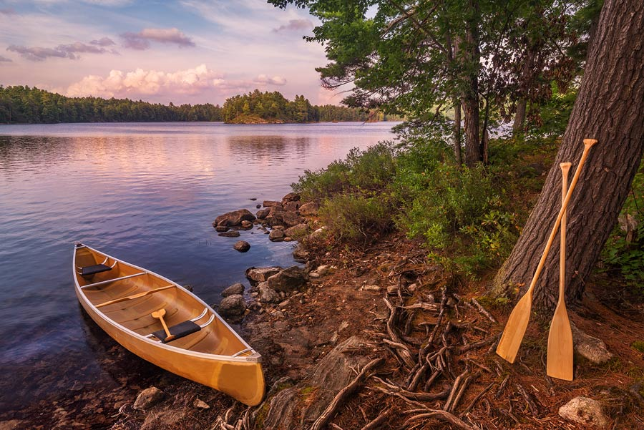

Slide 37
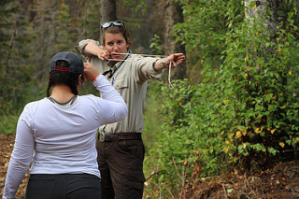
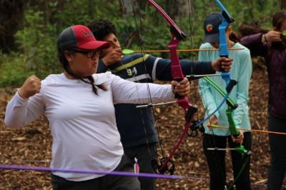
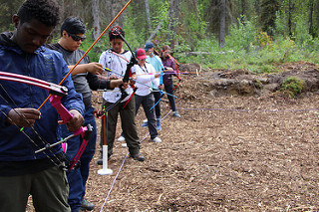

Slide 38
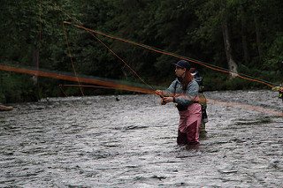

Slide 39
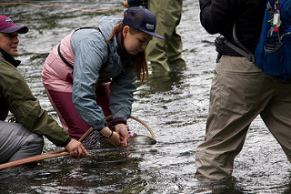

Slide 40
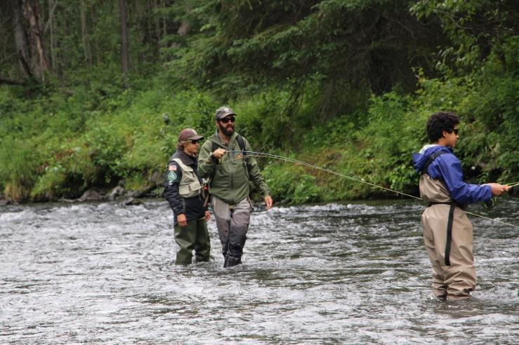

Slide 41
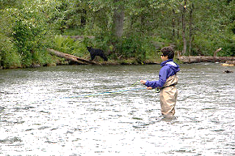

Slide 42
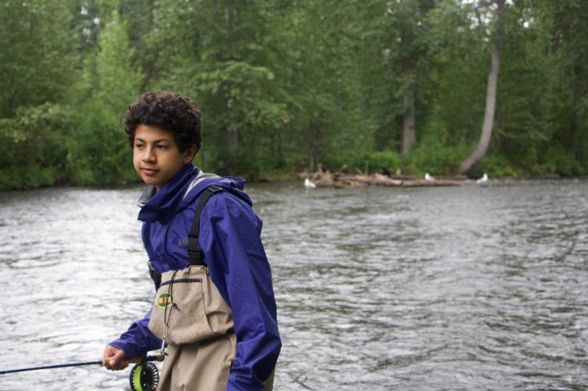

Slide 43



Slide 44
Future goals of the Stick and Sting Program
Improve connectivity of activities
Increase time on the water
Decrease time traveling to Outdoor Education Center
Utilize local experts
Develop a mentor program
Offer alumni events
Help plug S&S naturalists into local organizations that promote fishing events

Slide 45

"The great charm of fly-fishing is that we are always learning."
~Theodore Gordon

